Slide 1
Multimedia Technologies and Its Applications
Introduction to Multimedia
Introduction
Dr. Kwang-Bock You

Slide 2
What is Multimedia?

Slide 3
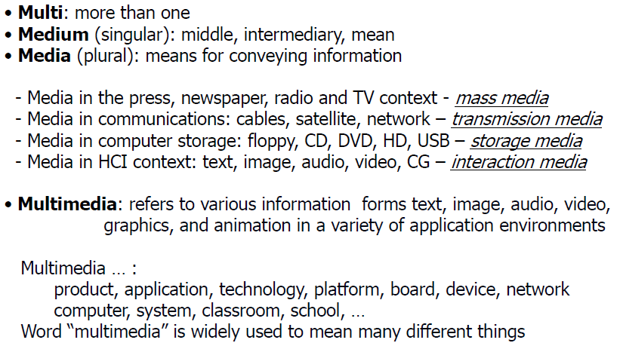
What is Multimedia?
3

Slide 4
What is Multimedia?
Four fundamental multimedia attributes:
Digitized: All media including audio and video are represented in digital format
Distributed: The information conveyed is remote distributed over networks
Interactive: It is possible to affect the information received, and send own information
Integrated: The media are treated in a uniform way but are possible to manipulate independently
4

Slide 5
What is Multimedia?
Definition of Multimedia:
Computer-based techniques of text, images, audio, video, graphics, animation, and any other medium where every type of information can be represented, processed, stored, transmitted, produced and presented digitally.
5

Slide 6
Introduction to Multimedia?
Multimedia can have many definitions these include:
A computer system perspective definition:
Multimedia means that computer information can be represented through audio, video, and animation in addition to traditional media (i.e., text, graphics/drawings, images).
6

Slide 7
Introduction to Multimedia?
A good general working definition is:
Multimedia is the field concerned with the computer
controlled integration of text, graphics, drawings, still and moving images (Video), animation, audio, and any other media where every type of information can be represented, stored, transmitted and processed digitally.
7

Slide 8
Is Multimedia Important?

Slide 9
Why is Multimedia Important?
Digital audio/video is revolutionizing music, film, game, and video & audio industries
Convergence of computers, telecommunication, radio, and TV
Caused by technology and competition
Dramatic changes in products and infrastructure
New application potential
Huge potential markets
Improving our lives (learning, entertainment, and work)
Interesting technical issues
9

Slide 10
Driving Forces for Multimedia Revolution
Evolution of communication and data networks
Ubiquitous access to network => “anywhere, anytime, any devices”
Fast processor and large capacity storage devices => Moore’s law
Compression techniques, graphics, computer vision, speech understanding... => New Techs.
Accessing and interacting the network with wired and wireless connections by smart terminals.
Digitization of virtually any device
10

Slide 11
Technological Aspects for Multimedia Revolution
Techniques for compressing and coding the various media
Communications aspects
Techniques for accessing multimedia signals
Techniques for organizing, storing and retrieving multimedia
11

Slide 12
Multimedia Application Definition
A Multimedia Application is an application which uses a collection of multiple media sources - text, graphics, images, sound/audio, animation and/or video.
12

Slide 13
Multimedia Applications
Residential services
Business services
Education
Science and technology
Entertainment
Medicine, Web applications, etc.
13

Slide 14
Multimedia Systems
A Multimedia System is a system capable of processing multimedia data and applications.
A Multimedia System is characterized by the processing, storage, generation, manipulation and rendition of Multimedia information.
14

Slide 15
Characteristics of a Multimedia System
A Multimedia system has four basic characteristics:
Multimedia systems must be computer controlled.
Multimedia systems are integrated.
The information they handle must be represented digitally.
The interface to the final presentation of media is usually interactive.
15

Slide 16
Multimedia Data

Slide 17
Multimedia Data: Graphics
Format: constructed by the composition of primitive objects such as lines, polygons, circles, curves and arcs.
Input: Graphics are usually generated by a graphics editor program (e.g. Illustrator) or automatically by a program.
Graphics input devices: keyboard (for text and cursor control), mouse, trackball or graphics tablet.
Graphics standards: OpenGL, PHIGS, GKS
17

Slide 18
Multimedia Data: Images
Still pictures which (uncompressed) are represented as a bitmap (a grid of pixels).
Stored at 1 bit per pixel (Black and White), 8 Bits per pixel (Grey Scale, Color Map) or 24 Bits per pixel (True Color).
Compression is commonly applied.
18

Slide 19

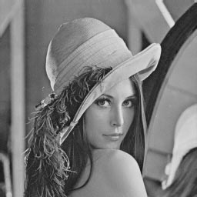
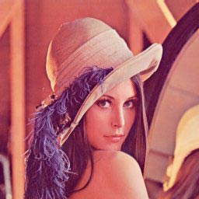
Multimedia Data: Images
Monochrome 1-bit Lena image
Grayscale image of Lena
24-bit color image “lena.bmp"
19

Slide 20
Multimedia Data: Audio
Audio signals are continuous analog signals.
Input: microphones and then digitized and stored
CD Quality Audio requires 16-bit sampling at 44.1 KHz
Usually compressed (E.g. MP3, AAC)
20

Slide 21
Multimedia Data: Video
Input: Analog Video is usually captured by a video camera and then digitized.
There are a variety of video (analog and digital) formats
Raw video can be regarded as being a series of single images. There are typically 25, 30 or 50 frames per second.
High Definition video on Blu-ray (up to 1920 1080 = 2 Megapixels per frame) 6:2 25 = 155MB for a second to store uncompressed. (There are higher possible frame rates!)
Digital video clearly needs to be compressed for most times.
21

